Slide 1
PROGRAMMING FOR PROBLEM SOLVING LECTURE COMPANION
SEMESTER: 1

Slide 2
Introduction to computer and programming Flowcharts and Algorithms
INTRODUCTION
A typical programming task can be divided into two phases:
Problem Solving Phase
Developing the algorithm.
Drawing the flowchart.
Implementation Phase
Implement the program in some programming language.

Slide 3
Introduction to computer and programming Flowcharts and Algorithms
ALGORITHM
Definition
”An algorithm is a sequence of steps written in the form of English phrases that specify the tasks that are performed while solving a problem.”
It helps the programmer in breaking down the solution of a problem into a number of sequential steps.
Corresponding to each step a statement is written in a programming language.

Slide 4
Introduction to computer and programming Flowcharts and Algorithms
ALGORITHM
Qualities of Good Algorithm
Input and output should be defined precisely.
Each step in the algorithm should be clear and unambiguous.
Algorithms should be most effective among many different ways to solve a problem.
An algorithm shouldn't include computer code. Instead, the algorithm should be written in such a way that it can be used in different programming languages.

Slide 5
Introduction to computer and programming Flowcharts and Algorithms
ALGORITHM
Advantages of Algorithm
It is a step-wise representation of a solution to a given problem, which makes it easy to understand.
An algorithm uses a definite procedure.
It is not dependent on any programming language, so it is easy to understand for anyone even without programming knowledge.
Every step in an algorithm has its own logical sequence so it is easy to debug.
By using algorithm, the problem is broken down into smaller pieces or steps hence, it is easier for programmer to convert it into an actual program

Slide 6
Introduction to computer and programming Flowcharts and Algorithms
ALGORITHM
Disadvantages of Algorithm
Writing algorithm takes a long time.
An Algorithm is not a computer program, it is rather a concept of how a program should be.

Slide 7
Introduction to computer and programming Flowcharts and Algorithms
ALGORITHM EXAMPLES
Example 1: Write an algorithm to add two integers and display the result.
Step 1: Start
Step 2: Declare variables num1, num2 and sum.
Step 3: Read values for num1, num2.
Step 4: Add num1 and num2 and assign the result to a variable sum.
Step 5: Display sum
Step 6: Stop

Slide 8
Introduction to computer and programming Flowcharts and Algorithms
ALGORITHM EXAMPLES
Example 2: Write an algorithm to find out whether a given number is even or odd.
Step 1: Start
Step 2: Take any number and store it in n
Step 3: if n=multiple of 2 print "even" else print "odd"
Step 4: Stop

Slide 9
Introduction to computer and programming Flowcharts and Algorithms
ALGORITHM EXAMPLES
Example 3: Write an algorithm to find out whether a given number is prime or not.
Step 1: Start
Step 2: Read number n
Step 3: Set f=0
Step 4: For i=2 to n-1
Step 5: If n mod 1=0 then
Step 6: Set f=1 and break
Step 7: Loop
Step 8: If f=0 then print 'The given number is prime' else print 'The given number is not prime'
Step 9: Stop

Slide 10
Introduction to computer and programming Flowcharts and Algorithms
ALGORITHM EXAMPLES
Example 4: Write an algorithm to find largest number amongst three numbers.
Step 1: Start
Step 2: Declare variables a, b and c.
Step 3: Read variables a, b and c.
Step 4: If a > b If a > c
Display a is the largest number.
Else
Display c is the largest number.
Else If b > c
Display b is the largest number.
Else
Display c is the greatest number.
Step 5: Stop

Slide 11
Introduction to computer and programming Flowcharts and Algorithms
FLOWCHART
Definition
”It is defined as the pictorial representation of a process, which describes the sequence and flow of control and information within the process.”
The flow of information is represented inside the flowchart in a step by step form.
Flowchart uses different symbols for depicting different activities, which are performed at different stages of a process.

Slide 12
Introduction to computer and programming Flowcharts and Algorithms
FLOWCHART
Advantages of Flowchart
The flowchart is a good way of conveying the logic of the system.
Facilitates the analysis of the problem.
Provides a proper documentation.
Easy identification of the errors and bugs.
It directs the program development.
Maintenance of the program becomes easy.

Slide 13
Introduction to computer and programming Flowcharts and Algorithms
FLOWCHART
Disadvantages of Flowchart
The complex logic could result in the complex flow chart.
A flowchart must be recreated to employ modification and alterations.

Slide 14
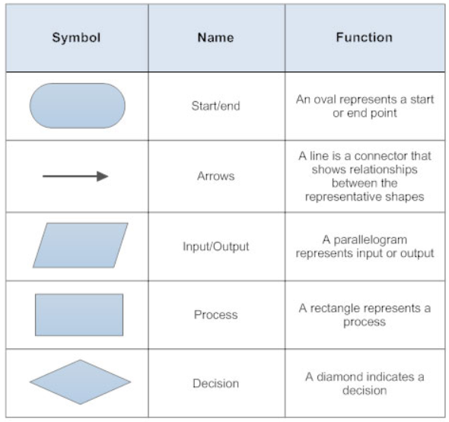
Introduction to computer and programming Flowcharts and Algorithms
FLOWCHART
The various symbols used in a flowchart are:

Slide 15
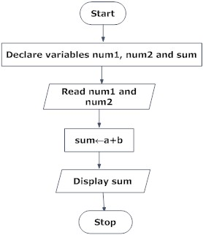
Introduction to computer and programming Flowcharts and Algorithms
FLOWCHART EXAMPLES
Example 1: Draw a flowchart to add two integers and display the result.

Slide 16
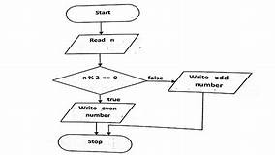
Introduction to computer and programming Flowcharts and Algorithms
FLOWCHART EXAMPLES
Example 2: Draw a flowchart to find out whether a given number is even or odd.

Slide 17
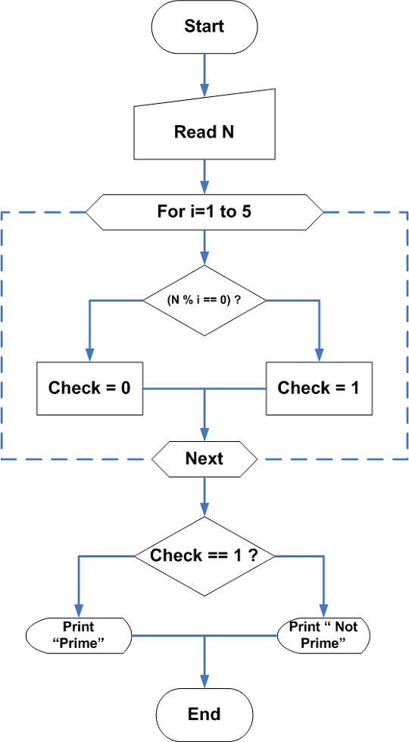
Introduction to computer and programming Flowcharts and Algorithms
FLOWCHART EXAMPLES
Example 3: Draw a flowchart to find out whether a given number is prime or not.

Slide 18
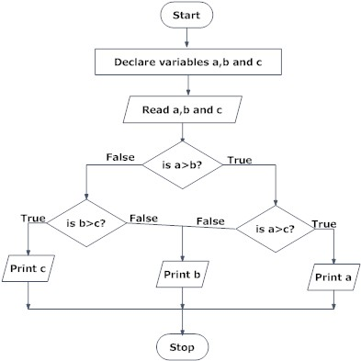
Introduction to computer and programming Flowcharts and Algorithms
FLOWCHART EXAMPLES
Example 4: Draw a flowchart to find largest number amongst three numbers.

Slide 19
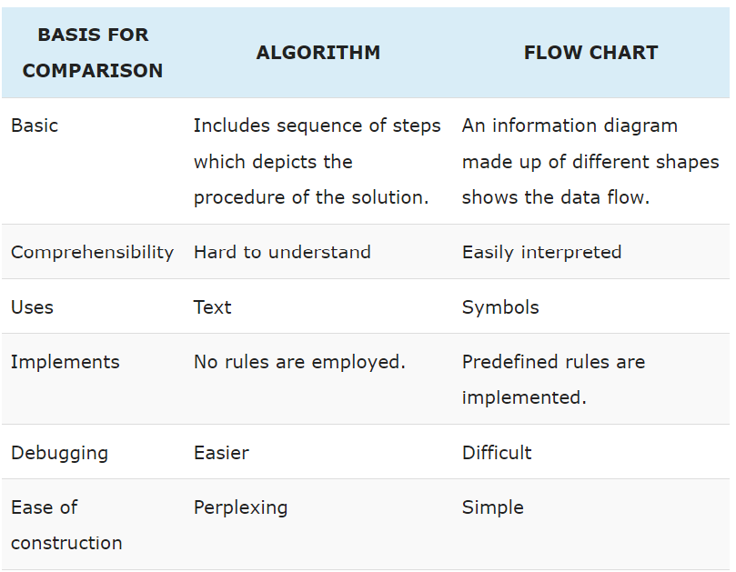
Introduction to computer and programming Flowcharts and Algorithms
COMPARISION BETWEEN ALGORITHM AND FLOWCHART

